Slide 1
HIE Use Case Development Principles
September 2020
Notes:
1

Slide 2
Learning Objectives
Communicate the benefits of a Use Case
Identify a Use Case scenario / ‘user story’
Develop a Use Case with recommended elements

Slide 3
Topics
Use Case Introduction
Elements of a Use Case
Development Guidance
Use Case Examples
Key Takeaways

Slide 4
Use Case Introduction
What is a Use Case?
  A well-crafted Use Case is an easy-to-understand description that details the interaction between an actor (human, organization, system) and a system under consideration
  For HIE purposes, a Use Case identifies Trading Partners, Source and Destination systems, and the intended use of HIE
Why do we utilize Use Cases?
  Use Cases are developed with a goal in mind, which makes them a valuable planning tool
  A Use Case communicates the functional requirements to inform the technical planning
  Having Use Cases available prior to technical discussions helps scope the technical solution and accelerates the technical evaluation process

Slide 5
Use Case Introduction
How do Use Cases assist in implementing HIE?
  Understand the business need early on in the process
  Issue you seek to resolve, or opportunity on which you intend to capitalize
  Define specific goals and objectives
    For instance:
      “I need to join the HIway”
» Lacks specificity
      “Our Practice needs to securely send summary of care records to my
      patients’ specialists to improve care coordination and avoid delays”
» Provides initial needed details to guide plan development,
scope the effort, and establish priorities
  Accelerate the development and implementation
  Define a basis for measuring and evaluating success
“Our Practice needs to generate and securely send summary of
care records to my patients’ specialists to meet MU2, Transition of Care criteria.”

Slide 6
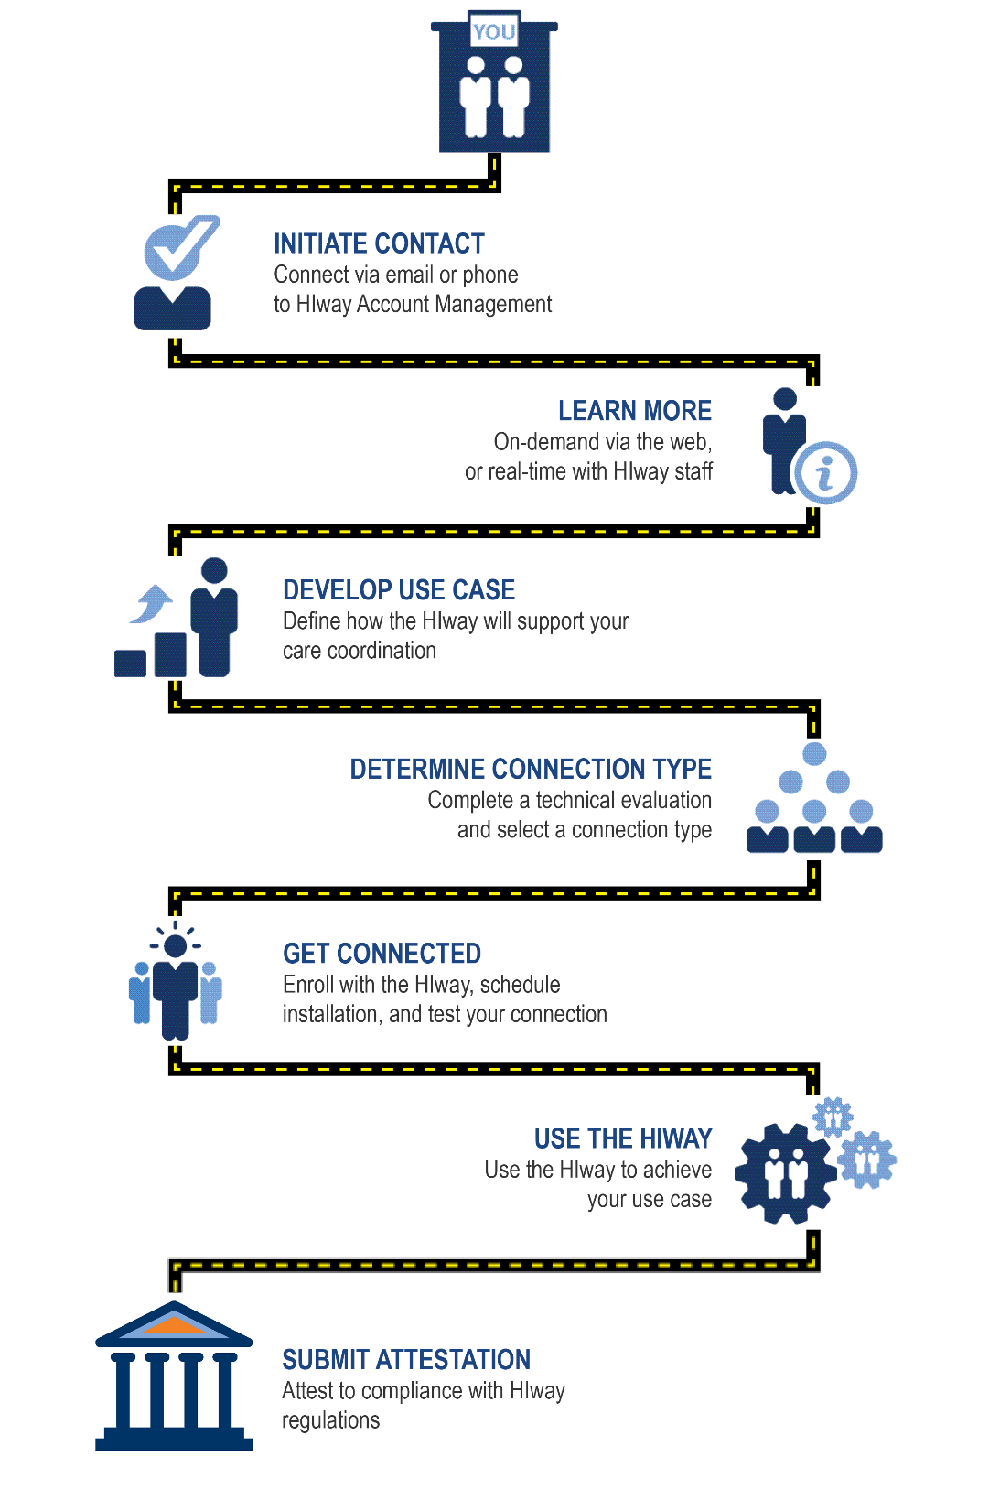
Use Case Context for HIway Connection
A key milestone on the HIway connection path

Slide 7
Use Case Benefits
Identifies the clinical and business needs before starting the development of the solution, which avoids rework and delays
Facilitates initial scoping, project planning, and prioritization
Supports "selling" your request to management
  Do your due diligence to articulate value and the right functionality
Supports identifying the project team and stakeholders

Slide 8
Next Topic
Use Case Introduction
Elements of a Use Case
Development Guidance
Use Case Examples
Key Takeaways

Slide 9
Use Case Elements
Use Case name
Goal
Story
Trading Partners
Systems
Data to exchange
Summary overview
Important detail

Slide 10
Use Case Elements (Summary overview)
Use Case name
  Brief summary of your Use Case (limit to 100-characters)
    Example: Patient referral from PCP to Specialist
Goal
  What you want to accomplish
    Example: To improve care coordination
          To reduce delays in care
          To reduce errors in patient information

Slide 11
Use Case Elements (Summary overview)
Story
  Description of how you intend to use HIE
    Perspective > A provider referring a patient to a specialist
    Context > The referring provider has made the determination that it is clinically and legally appropriate to send a referral and summary of care to the specialist.
    Story
      Dr. Jones, the referring provider, searches for a patient in the practice‘s EHR and initiates a referral message. The referral reason is described in the message. In some cases the referral is directed to a specific specialist, and in other cases to a specialist practice. Dr. Jones attaches a summary of care for reference, and then sends the referral.
      Dr. Smith, the specialist, sees the new referral in her local practice EHR. If this is a new patient for the practice, a new patient is created in the EHR. The core referral and the various documents are imported into the new patient's chart.
Reference: The Direct Project, User Stories
http://wiki.directproject.org/Primary+care+provider+refers+patient+to+specialist+including+summary+care+record

Slide 12
Use Case Elements (Important details)
Trading Partners
  The senders and receivers of health information
  People, roles, specialty, organizations:
    People = Dr. Jones, Nurse Thompson
    Roles = Case Manager, Triage Nurse
    Specialty = Oncology Specialists, Primary Care
    Organizations = Hospital ABC, Medical Associates of XYZ
      When describing the organization include relevant information
      such as number of beds, providers, visits per month.
Source, destination, and intermediary systems (e.g. EHR, HIE)
When describing systems include vendor names and versions
Data to exchange
  The data you intend to exchange

Slide 13
Selecting Trading Partners
Potential Trading Partners for HIE Use Case
  Select external care providers who you frequently interact
  with to provide care for the same patients
  Select Use Cases where HIE can have a significant impact
  on improving the care of these patients
  Discuss with these providers whether they already have HIE,
  or are willing to implement an HIE solution
  Visit the HIway Connections Map to view potential trading partners who use the Mass HIway:
  https://mehi.masstech.org/education/mass-hiway-directory

Slide 14

Example Data Sets
CCD (Continuity of Care Document)
  Commonly used type of electronic document that summarizes patient information and helps providers communicate clinical information via HIE during transitions of care
Patient name
Sex
Date of birth
Race **
Ethnicity **
Preferred language
Care team member(s)
Allergies **
Medications **
Care plan 11. Problems **
Laboratory test(s) **
Laboratory value(s)/result(s) **
Procedures **
Smoking status **
Vital signs
Meaningful Use Data Set
Minimum data that needs to exchanged to meet the Meaningful Use HIE objective
NOTE: Data requirements marked with (**)
have a defined vocabulary which must be used.

Slide 15
Next Topic
Use Case Introduction
Elements of a Use Case
Development Guidance
Use Case Examples
Key Takeaways

Slide 16
Use Case Guidance
  Limit the Use Case overview to 1-2 page(s)
  Engage your clinical and business leaders early
  Align to business and clinical objectives
  Complete the identified elements in 2 phases:
    Phase 1: Name, Perspective, Context, Story
    Phase 2: Trading Partners, Systems, Data to Exchange
  Tell the story of how you will use the solution once built
    Do not describe technical connectivity (i.e. S/MIME vs. XDR)
  Make the Use Case specific
    Select a well-defined area of focus and add in appropriate detail

Slide 17
Next Topic
Use Case Introduction
Elements of a Use Case
Development Guidance
Use Case Examples
Key Takeaways

Slide 18
List of Use Case Scenarios
Use Case | Type of Transaction | Care Setting | To Care Setting
1.1 | Referral -- Summary of care record | PCP | Specialist
1.2 | Consult note -- Summary of care record | Specialist | PCP
2.1 | Referral -- Summary of care record | PCP or specialist | Hospital
2.2 | Hospital admission notification | Hospital | Referring physician and/or PCP
3.1 | Hospital ED visit summary | Hospital | Referring physician and/or PCP
3.2 | Hospital discharge summary | Hospital | Referring physician and/or PCP
3.3 | Hospital discharge summary | Hospital | Other care settings (i.e. SNF)
4.1 | Hospital admission notification | Hospital | Referring Hospital
4.2 | Hospital discharge summary | Hospital | Hospital
5.1 | Public Health Reporting | PCP or specialist | Public health
5.2 | Public Health Reporting | Hospital | Public Health

Slide 19


Scenario 1.1 – Referral
Care Coordination – Provider to Provider
Referral
HIE
PCP
Specialist
Consult Note
Patient Scenario
1. Patient sees PCP
2. PCP’s plan includes a referral to a Cardiac specialist
3. Referral to specialist is generated with a summary of care document and attached to a Direct Message
4. Direct Message is sent via HIE to Cardiac specialist
Specialist
A. Receives Direct Message with summary of care document
B. Provides necessary care
C. Generates a consult note for delivery to PCP
D. Consult note is attached to a Direct Message and sent via HIE to PCP

Slide 20


Scenario 2.1 – Hospital Referral
Care Coordination – Hospital to Provider / Provider to Hospital
Specialist
HIE
PCP
Patient Scenario
1. Patient sees PCP or specialist
2. Treatment plan includes a referral to a local hospital
3. Referral to hospital is generated with a summary of care document and attached to a Direct Message
4. Direct Message is sent via HIE to hospital
Hospital
A. Receives the Direct Message with the referral and summary of care document
B. Provides necessary care
C. Generates an admission notification and summary of care document
D. Admission notification is sent via HIE to PCP and/or specialist

Slide 21
Scenario 3.1 – ED Notification
Specialist
HIE
PCP
Patient Scenario
1. Patient presents at Emergency Department
2. Patient is treated and released
Hospital
A. Provides necessary care
B. Generates an admission notification and summary of care document
C. Admission notification sent via HIE to PCP and/or specialist

Slide 22

Scenario 3.2/3.3 – Discharge Summary
The image cannot be displayed. Your computer may not have
Specialist
HIE
PCP
The image cannot be displayed. Your computer may not have
SNF
Patient Scenario
Hospital
A. Provides necessary care
B. Generates a discharge summary and summary of care document
C. Discharge summary is sent via HIE to referring physician, PCP, and/or other care setting
1. Patient is discharged from hospital to the care of a referring physician, PCP or other care setting

Slide 23
Scenario 4.1/4.2 – Referral
HIE
XYZ Hospital
ABC Hospital
XYZ Hospital
1. Patient admitted to XYZ ED
2. Treatment plan calls for a tertiary level of care
3. Patient is referred to ABC hospital
4. Referral and summary of care are generated and attached to a Direct Message
5. Direct Message is sent via HIE to ABC hospital
ABC Hospital
A. Patient is received at ABC hospital
B. ABC hospital receives Direct Message with referral and summary of care document
C. Provides necessary care
D. Generates a discharge summary and summary of care
E. Sends discharge summary and summary of care via HIE to XYZ hospital

Slide 24



Public Health Use Cases
PCP
Dept. of Public Health
Immunization Reporting
Electronic Lab Reporting
Syndromic Surveillance
CANS Assessments (CBHI)

Slide 25
Next Topic
Use Case Introduction
Elements of a Use Case
Development Guidance
Use Case Examples
Key Takeaways

Slide 26
Key Takeaways
Develop Use Cases to:
Identify clinical and business needs before solution development
Develop the goal and objectives
Communicate clinical, business, and functional requirements
Facilitate initial scoping, project planning and effort prioritization
Elements of a Use Case include:
Use Case name
Goal
Story
Trading Partners
Systems
Data to exchange
Summary overview
Important detail

