Slide 1





CARE COORDINATION
USE CASE
CARE COORDINATION FOR SUBSTANCE USE DISORDER PATIENTS
Substance Abuse Treatment Centers
e
Referrals
Ordering
& sharing referral
status
Discharge
Summaries
Medication
&
Treatment
Status
Hospitals
Mental Health
Facilities
Shared
Care
Plans
Integrated
Healthcare Centers
Developing
workflows
at each
provider
Consistent
referral and
privacy protocols between providers
Content,
data set and
formatting
standards
Developing
technical infrastructure
to support
Some facilities
will be building connections to
the MA HIway
GOALS
Icons provided by MeHI at mehi.masstech.org/Icons

Slide 2
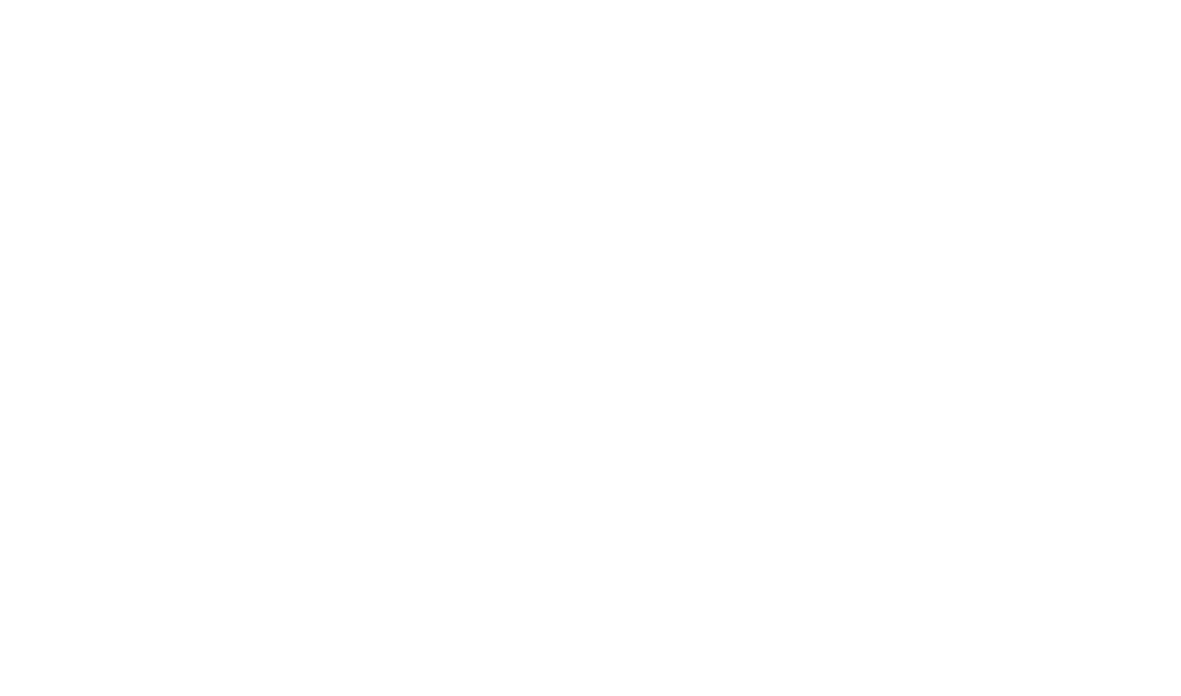
CARE COORDINATION
USE CASE
CARE COORDINATION FOR SUBSTANCE USE DISORDER PATIENTS
ORGANIZATION
STORY
Federally Qualified Community Health Center.
Joe is struggling with opioid abuse issues and he is facing a healthcare system that is not well coordinated between primary care, hospitals and behavioral health providers. Yet, Joe is a very high risk patient, who is complex to manage. Joe and others with SUD are the most frequent patients to visit the ER. Tight coordination between treatment providers is essential in order for Joe to attain a successful patient outcomes. Care for Joe will be more tightly coordinated across the care continuum which will prevent relapses and hospital re-admissions. Avoiding relapses is a critical goals since many deaths due to drug overdoses occur immediately after relapses.
No matter where the patient presents, trading partners can easily refer the patient to be treated at the most appropriate provider. Patient consents, medication and treatment information will be shared across providers to provide for a tighter, more inclusive care continuum with no gaps.
GOAL
Better coordination of care for patients with substance use disorder, sharing eReferrals, treatment and medication status, discharge summaries and care plans in order to attain better patient outcomes and reduce costly readmissions.
TRADING PARTNERS AND SYSTEMS
Hospital;
Substance Abuse Treatment Centers;
Mental Health Facilities.
DATA TO EXCHANGE
Referrals, medication and treatment status, care plans, discharge summaries, consents.
Icons provided by MeHI at mehi.masstech.org/Icons

