Slide 1
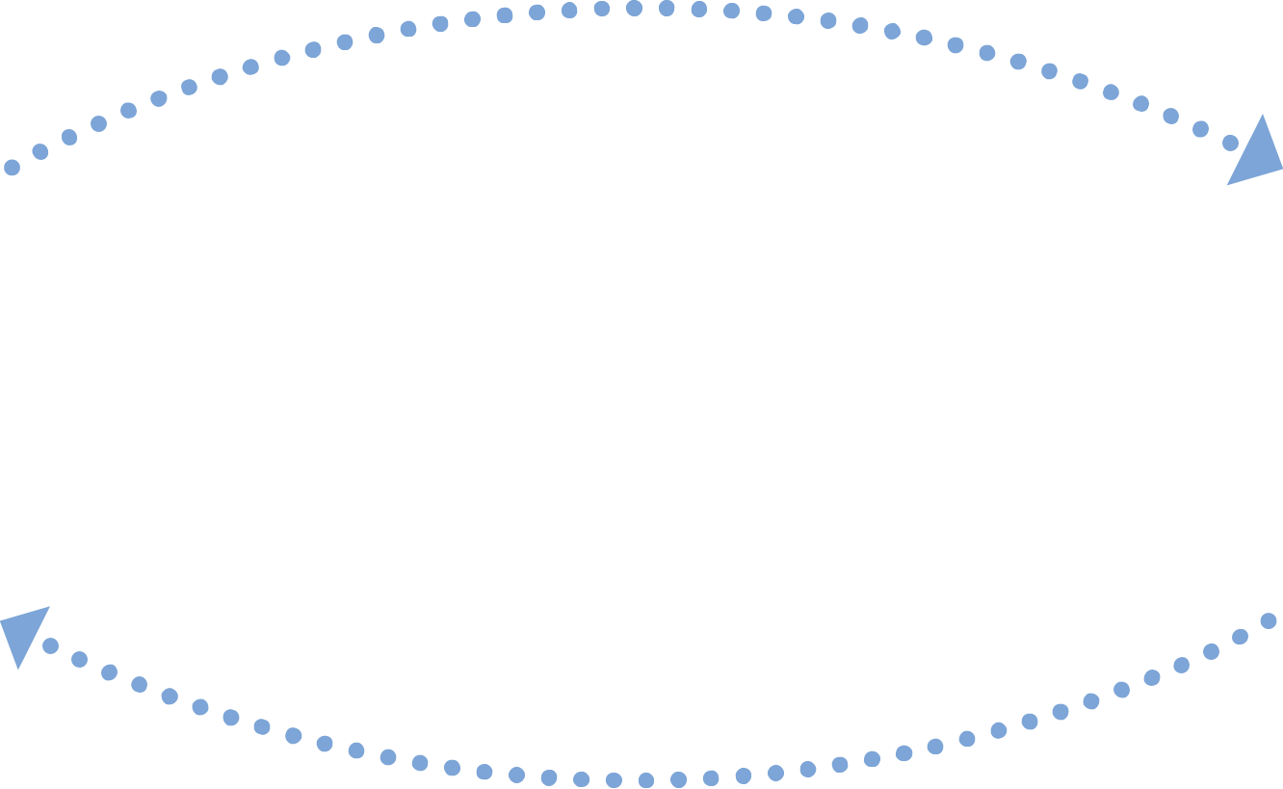


CARE COORDINATION
USE CASE
CARE PLAN DOCUMENT EXCHANGE BETWEEN
A MASSHEALTH ACO AND ITS COMMUNITY PARTNERS
Care Plan sent via Direct Message from Family Continuity to MVACO
FAMILY CONTINUITY
Merrimack Valley ACO
PCP sends reviewed and signed Care Plan back to Family Continuity via Direct Message
Facilitate the electronic exchange of care plans between MassHealth Accountable Care Organizations and Community Partners to reduce time delays and attain better patient outcomes.
GOAL
Icons provided by MeHI at mehi.masstech.org/Icons

Slide 2
CARE COORDINATION
USE CASE
CARE PLAN DOCUMENT EXCHANGE BETWEEN
A MASSHEALTH ACO AND ITS COMMUNITY PARTNERS
STORY
ORGANIZATION
Merrimack Valley ACO (MVACO) regularly exchanges care plans with its MassHealth Community Partners, including Family Continuity. Under the MassHealth ACO program, the Community Partners provide behavioral health or long-term support and services to MassHealth-covered patients. Family Continuity is a non-profit mental health and social services agency that supports Eastern and Central Massachusetts.
Care plans are generated by a Community Partner to assist providers in keeping their shared patients safe, healthy, and out of the hospital. A Community Partner works with their patient to complete a care plan, and the plan is then sent to MVACO for the patient’s Primary Care Physician (PCP) to review, update as needed, and sign. The PCP then sends the signed care plan back to the Community Partner.
In the past, MVACO and Family Continuity used faxes and phone calls to communicate. As this method took significant time to complete, MVACO worked with Family Continuity and HIway Account Managers to implement an electronic workflow that improved the process of exchanging the care plans. In the new workflow, a staff member at Family Continuity electronically sends the care plan to MVACO via Direct Messaging over the Mass HIway. Once the care plan is received, it is forwarded to the appropriate physician who reviews and signs it, before sending it back to Family Continuity as a PDF via
another Direct Message.
Merrimack Valley ACO (MVACO)
GOAL
Facilitate the exchange of care plans between MassHealth Accountable Care Organizations and Community Partners providing long term support or behavioral health services.
TRADING PARTNERS AND SYSTEMS
MVACO
Family Continuity
DATA TO EXCHANGE
Care Plans
READ
THE FULL STORY
Icons provided by MeHI at mehi.masstech.org/Icons

